Slide 1

OPERATIONAL INNOVATION PITCH
Automating the Workflow
Decision Sheet
A proactive technological initiative replacing high-latency manual scanning and extraction with a high-throughput Python engine.

Slide 2

The Operational Bottleneck
Examining the friction, human overhead, and throughput constraints of legacy Decision Sheet ingestion into DMS.

Slide 3


Manual Ingestion Friction
■
Multi-Step Document Preparation: Decision sheets require manual Word-to-PDF conversion prior to DMS ingestion.
■
Granular Embedding Extraction: Each embedded object must be opened, extracted, and independently converted one-by-one.
■
Productivity Choke Point: Disproportionate staff hours spent on routine conversion instead of analytical validation.
■
Human Factor Vulnerability: High manual touchpoints increase omission risks across complex embedded appendices.

Slide 4
Automation Evolution Roadmap
Phase 1: Bulk Doc
Introduced 1-click batch Word-to-PDF tool to stabilize initial ingestion.
Phase 3: Pipeline
End-to-end ingestion pipeline with direct enterprise DMS sync.
Phase 0: Legacy
Phase 2: Extractor
Entirely manual conversion of base Word docs and nested files individually.
Automated backend extracting and standardizing all embedded artifacts.

Slide 5
Operational Efficiency Gain
Eliminating Human Interaction in Repetitive Extraction
90%
The Python-based embedding extractor systematically unpacks, parses, and converts all nested files directly inside the document package without human intervention.
Manual Touchpoint Reduction
This leap frees up departmental capacity, shortens the turnaround cycle for executive decision records, and guarantees standardized formatting across all uploads.

Slide 6
The Technical Solution
How an in-house Python engine handles complex embedded compound files with precision, speed, and integrity.

Slide 7



Core Architectural Capabilities
OLE & XML Parsing
Automated Conversion
DMS-Ready Bundling
Recursively reads document packages to isolate embedded spreadsheets, presentations, and binary artifacts.
Translates extracted child objects into standardized PDF equivalents while preserving original naming metadata.
Structures final output into indexed parent-child folders ready for direct, compliant batch DMS archiving.

Slide 8
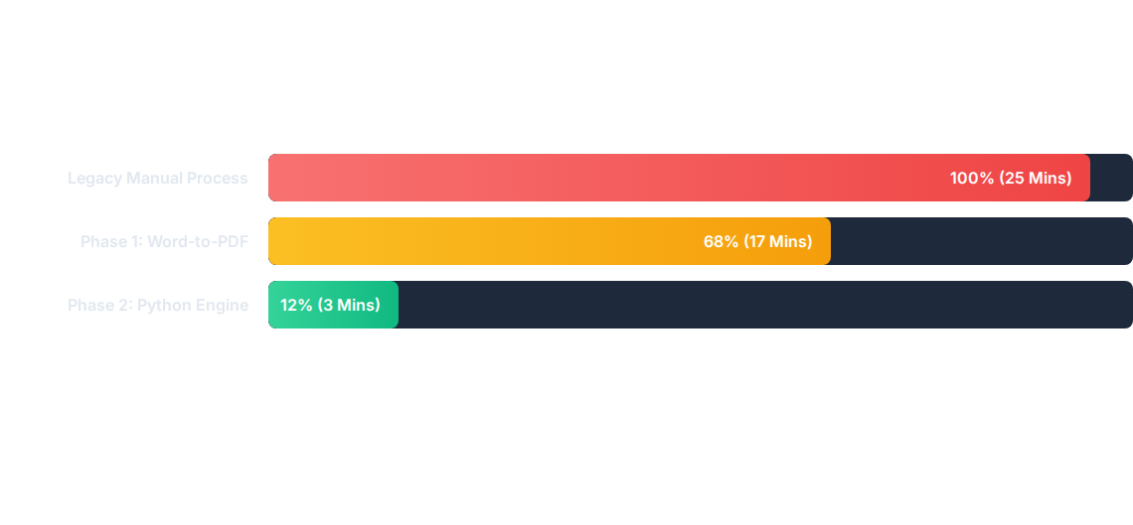
Processing Time per Package
Cycle time drops from approximately 25 minutes per multi-attachment decision package to under 3 minutes per bundle.

Slide 9
Phased Capability Matrix
Operational Attribute | Manual Process | Phase 1 (Bulk Tool) | Phase 2 (Python Extractor)
Base Document Conversion | Manual per document
Nested Embedding Handling | Manual individual extraction | Manual individual extraction
Touchpoint Interaction | High (~15-20 actions) | Moderate (~8-10 actions)
Scalability Under Peak Load | Severely constrained | Partially constrained
Batch 1-Click
Autonomous Pipeline
Automated OLE Extraction
Minimal (1 Batch Action)
Linearly Scalable

Slide 10
Implementation & Governance
1. Enterprise IT Approvals
2. Staging & Infrastructure
Unlike standalone desktop macros, running Python services requires standard execution permissions and security review. We have structured the script to operate inside sandbox guidelines, ready for corporate IT compliance inspection.
Initial resource constraints in local workstation environments can be systematically addressed through a lightweight departmental staging container, validated during controlled production pilot phases.

Slide 11
Strategic Leadership Mindset
We come to leadership with actionable solutions rather than complaints. This is our foundation for the upcoming automation era.
"
"
— Departmental Operational Philosophy

Slide 12
A Strategic Win-Win
Approval deploys 90% automation without adding budget. A deferral provides transparent evidence of high workload to justify headcount allocation.
Open for Review & Pilot Deployment

Slide 13

Image Sources
https://as2.ftcdn.net/v2/jpg/18/96/65/45/1000_F_1896654561_mkiyzALVOb0ZB4sacJuExm0PqJIHB9mi.jpg
Source: www.europosters.hu

